Slide 1
A Seminar on YOLO WITH INTEGRATED MULTI-SCALE DOMAIN ADAPTATION
Team Details Team No-18
G. Yashwanth
G. Sampath Reddy
S. Teja Reddy
Project Supervisor Mrs.B.Ujwala Assistant Professor
(21EG505827) (21EG505829) (21EG505859)

Slide 2
Introduction
Convolutional Neural Networks (CNNs) excel at identifying and locating objects in images, but their performance can drop when faced with a domain shift. This happens when the testing data differs from the training data, such as changes in lighting, weather, or viewpoints. For instance, training data for autonomous vehicles is usually collected in clear weather, but testing might occur in challenging conditions like rain or fog. The training domain is called the source domain, and the new testing domain is the target domain. This shift can significantly impact the accuracy of object detection models.

Slide 3
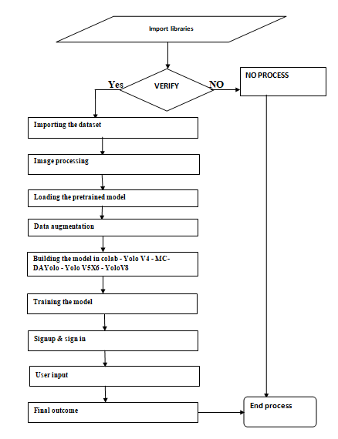
Concept Tree

Slide 4
Literature
Author(s) | Method | Advantages | Disadvantages
Alexey Bochkovskiy, Chien-Yao Wang (2020) | Convolutional Neural Networks (CNN) | 1.Performance Enhancement. 2.Real-Time Speed. | 1.Multiple complex features leads to heightened computational requirements. 2.Feature Selection Challenge indicating the complexity of optimizing the model.
Yu Wang, Rui Zhang (2021) | Domain-Specific Suppression, Separation of Directions, Backpropagation Constraints | Enhanced Robustness in Challenging Weather Conditions. 2.Domain-Invariant Feature Extraction | 1. Increased computational complexity due to the additional constraint in backpropagation. 2. May require fine-tuning for specific domain adaptation tasks.

Slide 5
Literature
Author(s) | Method | Advantages | Disadvantages
Vibashan VS, Vikram Gupta (2021) | Memory Guided Attention (MeGA), Category-Aware Domain Adaptation (CDA), Domain-Invariant Feature Alignment | 1. Improved Object Detection Performance. 2. Outperforms State-of-the-Art Techniques. | 1. Potential computational complexity and hardware requirements for real-time implementation in practical applications. 2. Challenges related to handling large and diverse category sets in complex scenes.

Slide 6
Literature
Author(s) | Method | Advantages | Disadvantages
Mazin Hnewa, Hayder Radha (2021) | Multiscale Domin Adaptive YOLO(MS-DAYOLO), Domain Adaptation Paths within YOLOv4. | 1. Improved Object Detection. 2. YOLOv4's multiple domain paths enhance robustness, adeptly handling diverse conditions. | 1. Computational demands pose challenges for real-time implementation in autonomous driving. 2. The adaptability of MS-DAYOLO to diverse real-world driving scenarios and varying weather conditions may require further exploration.
Wenyu Liu, Gaofeng Ren (2022) | Image-Adaptive YOLO (IA-YOLO), Differentiable Image Processing (DIP), CNN-PP (Convolutional Neural Network for Post-Processing). | 1.Adaptive Image Enhancement. 2. Customizable Image Processing | 1. Potential computational complexity for real-time application in autonomous driving or other safety-critical systems. 2. The adaptability of IA-YOLO to various adverse weather conditions and real-world driving scenarios may need further investigation.

Slide 7
Problem Statement
In order to solve the domain shift issue that many deep learning systems have run into, domain adaptation has shown to be crucial. The disparity between the distributions of the target data used in real-world testing scenarios and the source data used for training gives rise to this issue.
Our proposal is a new Multi-Scale Domain Adaptive YOLO (MS-DAYOLO) system that utilizes various domain classifiers at different scales of the YOLOv4 object detector together with numerous domain adaptation routes.
Existing Method Disadvantages:
Lack of Attention to YOLO-based Architectures
Limited Target Domain Data
Annotating Challenges

Slide 8
Problem Illustration
Current Deep learning systems often face the "domain shift issue," stemming from disparities between source and target data distributions, resulting in reduced performance in diverse real-world scenarios.
MS-DAYOLO addresses this challenge in object detection by integrating multiple domain adaptation routes and scale-specific domain classifiers within YOLOv4, systematically enhancing adaptability and robustness across varying real-world conditions. This approach aims to mitigate the impact of domain shift, ensuring improved performance in diverse and unseen environments.

Slide 9
Proposed Method
We proposes a novel Multi-Scale Domain Adaptive YOLO (MS-DAYOLO) framework that employs multiple domain adaptation paths and corresponding domain classifiers at different scales of the YOLOv4 object detector.
We introduces three novel deep learning architectures for a Domain Adaptation Network (DAN) that generates domain-invariant features. In particular, we propose a Progressive Feature Reduction (PFR), a Unified Classifier (UC), and an Integrated architecture. We train and test our proposed DAN architectures in conjunction with YOLOv4 using popular datasets.

Slide 10
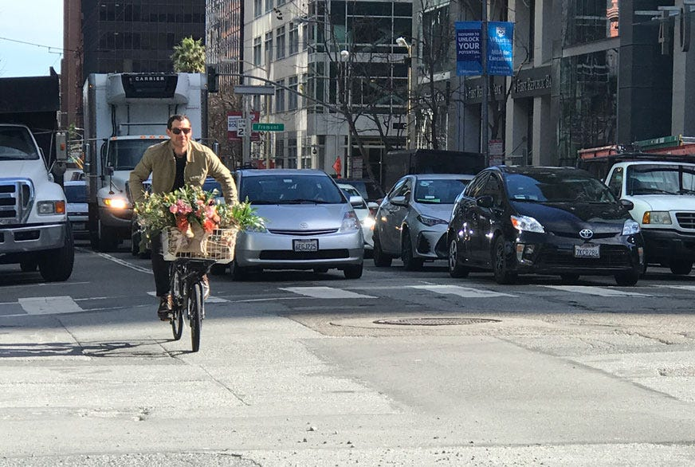
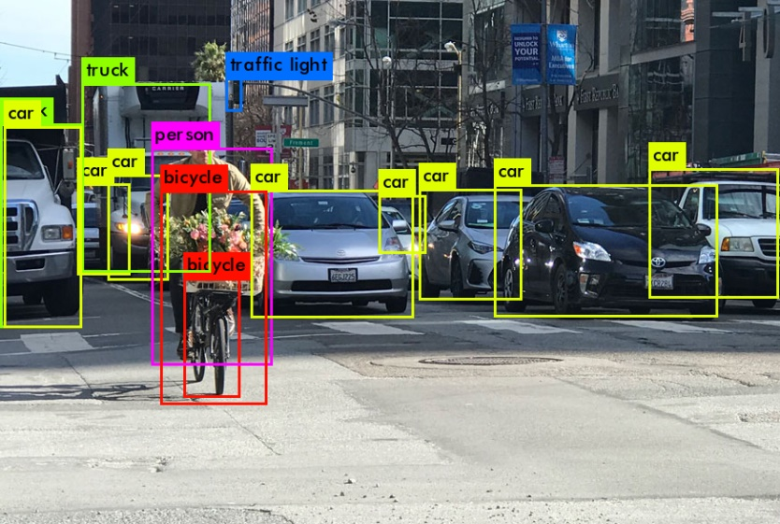
Proposed Method Illustration
Before object detection
After object detection
When we upload the image from the user end it will detect the objects in image with boundary boxes along with probability

Slide 11
Parameter
Parameters Considering :
Accuracy = True positive(TP) + True Negative(TN)/ (True positive(TP) + True negative(TN) + False positive(FP) + False negative(FN))
Recall = True Positive (TP) / True Positive (TP) + False Negative (FN)
Precision = True positive(TP)/ (True positive(TP) + False positive(FP))
F1 Score = 2/(1/precision + 1/recall)
5. F1 Score = 2*Precision*Recall / Precision + Recall

Slide 12
Experiment Environment
Tools:
Anaconda
Sqlite
Jupyter Notebook
Flask
Technologies:
HTML, CSS, JavaScript and Bootstrap
Language:
Python
Dataset:
The dataset is collected from kaggle. We can use the dataset for Detecting the object with the boundary boxes along with probability.

Slide 13
Project Status
S.No | Functionality | Status (Completed /in-progress/Not started)
01 | Research Paper Collection | Completed
02 | Dataset Collection | Completed
03 | Code Implementation: Training Testing | In-Progress
04 | Documentation | Not Started
Note: Submit Form 1,2 and 3

Slide 14
References
Alexey Bochkovskiy, Chien-Yao Wang, Hong-Yuan Mark Liao (2020), YOLOv4: Optimal Speed and Accuracy of Object Detection.
Yu Wang1,2,3 Rui Zhang1,2 Shuo Zhang2 Miao Li1,2,3 YangYang Xia2 XiShan Zhang1,2 ShaoLi Liu2 1SKL of Computer Architecture, Institute of Computing Technology, CAS, Beijing, China 2Cambricon Technologies, China 3University of Chinese Academy of Sciences, China (2021), Domain-Specific Suppression for Adaptive Object Detection.
Vibashan VS, Vikram Gupta, Poojan Oza, Vishwanath A. Sindagi, Vishal M. Patel (2021), MeGA-CDA: Memory Guided Attention for Category-Aware Unsupervised Domain Adaptive Object Detection
Mazin Hnewa, Hayder Radha (2021), Multiscale Domain Adaptive YOLO for Cross-Domain Object Detection.
Wenyu Liu, Gaofeng Ren, Runsheng Yu, Shi Guo, Jianke Zhu, Lei Zhang (2022), Image-Adaptive YOLO for Object Detection in Adverse Weather Conditions.

Slide 15
Thank You

